Slide 1
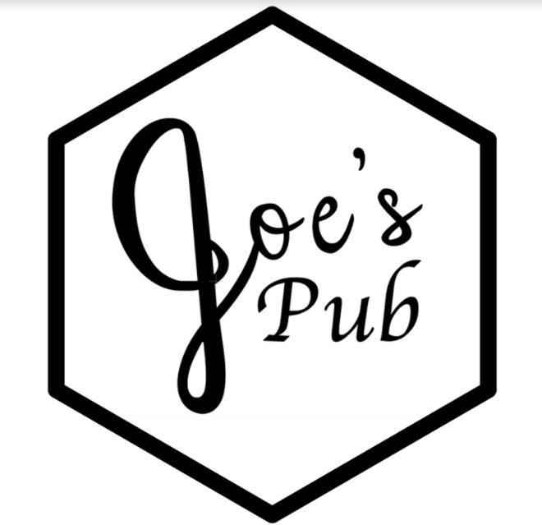
Note to Nik,
Lucida Calligraphy is the font Kerri use for “Pub” in the logo. Liberal use of this for headings is highly encouraged.
I’m starting to really embrace the black and white theme for my brand. This goes beyond MtG and includes my décor lately. So in the event that color might be included.... don’t
Also, if there’s somewhere you think you can put a hexagon.... do it!
About
Digital Menu
Instagram
Recipes
Welcome to
Est. 2016
New York Delaware
Aarhus-Denmark

Slide 2

About
Digital Menu
Instagram
Recipes
Our Story
Joe’s Pub started with a boy fascinated by the prospect of mixology. So many liquors, liqueurs, and mixers. So many combinations, ratios, and methods. So many glimmering, gleaming, glinting glasses. Scooped up in the romanticism, what was once a simple hobby, evolved into an outright obsession. With more bottles of alcohol than he had friends, our hero decided to take the knowledge he had learned and the skills he had accrued and present it all to the masses. He was no longer the starry-eyed dreaming boy who began this journey, now he was a man; more than that, he was a bartender.
Eventually, life took Joe on a harrowing adventure across the US and across the world. Joe’s Pub has proudly served cocktails in Rochester, NY; Binghamton, NY; Aarhus, Denmark; and Wilmington, DE, all the while spreading smiles, enjoyment, and quality entertainment.
Joe’s Pub has had the pleasure in competing in invited several cocktail competitions.
Above all, we promote an atmosphere of fun and jovial merriment where everyone knows your name and everyone feels at home. Libations are great in their own right, but a community to enjoy together built on mutual respect and interest can’t be beaten.
Rules
Joe’s Pub is a place where people can gather and have fun, if anything threatens that, it will be removed.
We work on the honor system. We do not check IDs, but expect that all of our patrons are honest about their legal age.
There is no last call, but everybody must be gone or going by 12:20 AM (local time)
We do not condone inebriated driving. Accommodations may be provided at our sister establishment—Joe’s Lounge—for anyone who seems incapable of operating a motor vehicle.
The bartender’s decision is always final
About Our Prices
Everything is for sale.... for the right price. We charge enough to breakeven. Not looking to turn a profit, not looking to rip anyone off, we just want some compensation for what we use.
Discounts, coupons, and special tastings are available, but granted at the bartender’s discretion. Chores, tasks, and odd jobs can be used for coupons or credits.
No compensation is required if your legal surname is, or may become, “Izzo”.
Payment may be made in the form of cash, via Venmo to the username @emubob59, or PayPal to jaizzo92@gmail.com.
If you don’t have means to pay readily available, a tab can be started and paid off at a later date, but this tab cannot exceed 10 USD or 65 DKK.
Money can be pre-paid and recorded by the bartender, but refunds are not available.
First visit is free.
Personnel
Joseph A. Izzo – Proprietor, master mixologist, creative genius
Stephen A. Izzo – Procurement specialist, chief cook and bottle washer
Kerri Cody – Brand manager, merchandise specialist
Nikolas J. Zagarella – Webmaster
Saptarshi Ghosh – Resident bum
Picture of Rochester bar
Picture of Binghamton bar vers1
Picture of Binghamton bar vers2
Picture of Aarhus bar
Picture of Wilmington bar
Picture of Art’s Christmas party
Picture of Isquare cocktail contest
Feel free to use an alias here if she doesn’t want her name on the internet.

Slide 3
About
Digital Menu
Instagram
Recipes
Note to Nik,
I’d like these to be pictures of one particular entry from each of the lists (we can discuss which ones later) with a label and link to the sub-page that has the menu listing. See https://www.groupjorgensen.com/ for reference.
I’ve started the “Classic Cocktails” on the next page.
Classic Cocktails
Pirated Cocktails
Original Cocktails
Premium Cocktails
Shots
Virgin Cocktails
Suggested Cocktails
Create your own adventure

Slide 4
About
Digital Menu
Instagram
Recipes
Links to other sub-pages, maybe?
Classic Cocktails, Pirated Cocktails, Original Cocktails, Premium Cocktails, Shots, Virgin Cocktails, Suggested Cocktails, and Create your own adventure.
Classic Cocktails
These are the cocktails that you can order in most any bar. They range from the simple to the complex. Most are well-publicized in the media and at bars. All of them are classics in their own right.
Cosmopolitan Vodka, triple sec, lime juice, cranberry juice
Gin & Tomic Gin, tonic water
Grasshopper Vanilla vodka, green crème de menthe, white crème de cocoa, half-and-half
Mai Tai White and dark rum, triple sec, orgeat syrup, lime juice, lemon juice
Margarita Tequila, Cointreau®, lime juice, salted rim

Slide 5
About
Digital Menu
Instagram
Recipes
This should just be the current NikZProjects website

Slide 6
About
Digital Menu
Instagram
Recipes
There’s no replacement for hand-crafted, homemade, and personalized ingredients. This is a list of the recipes for the syrups, bitters, mixers, and additives we use at Joe’s Pub to make your cocktails a memorable experience.
⬡JP’s Original Grenadine⬡
2 C granulated sugar
1 C pomegranate juice
1 Tbsp Maraschino cherry juice
Add ingredients in a small sauce pan and heat over medium heat, stirring occasionally. When solution begins to simmer, continue to stir for 5 min. Let cool. Transfer to a container (use a ketchup bottle if you want to startle people) and store in the fridge.
⬡JP’s Original Ginger Syrup⬡
¼ C peeled and diced ginger
1 C water
1 C granulated sugar
¼ vanilla bean
Add ingredients in a small sauce pan and heat over medium heat, stirring occasionally. Bring to a rolling boil. Reduce to a simmer for 15-20 min. Cool. Strain. Transfer to a container and store in the fridge.
⬡JP’s Original Cardamom Syrup⬡
1 C water
1 C white sugar
3 Tbsp crushed cardamom pods
Add ingredients to a pan over medium heat. Bring mixture to a rolling boil, stirring occasionally. Simmer for 5-10 min. Let cool. Place in a jar and store in the fridge for two days. Strain. Enjoy!

